Slide 1

NLP Final – AI Article Analysis
Aren Mizuno
March 12, 2026
ADSP 32018 – Ignas Grabauskas

Slide 2
Table of Contents
Data EDA and Preprocessing
Topic Detection
Named Entity Recognition (NER)
Sentiment Analysis
Results and Future Considerations

Slide 3
Data EDA and Preprocessing

Slide 4
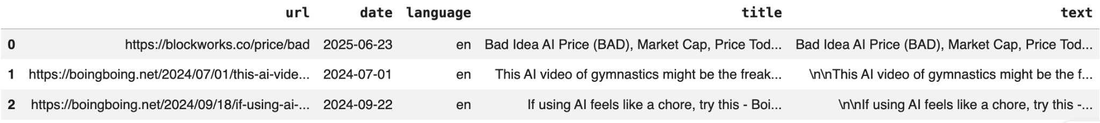
Data EDA and Preprocessing – Initial
199989 articles
No NaNs
All language = ‘en’
5 columns (all object dtypes)
Duplicates
0 url
494 text
35190 title
Drop all duplicates
Cleaned the title and text by removing links and extra whitespace
Capitalization, punctuation, and stop words kept for later tasks (NER), since they help models identify named entities like companies and technologies

Slide 5
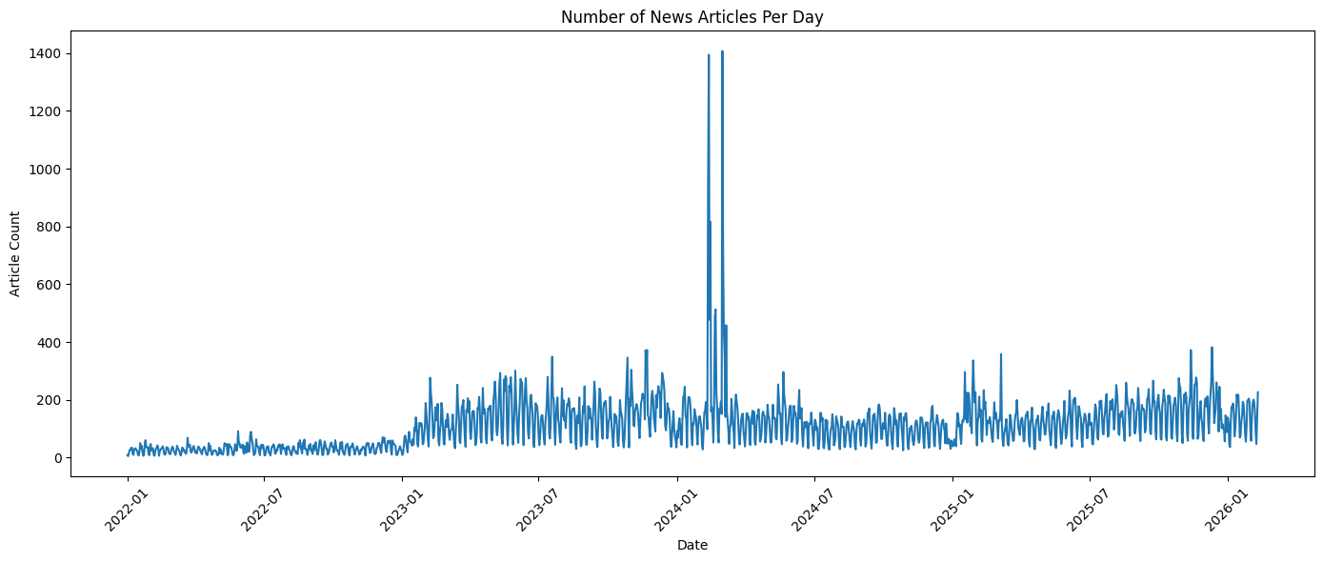
Data EDA and Preprocessing – Date/Time
Date range:
Min: 2022-01-01 00:00:00
Max: 2026-02-10 00:00:00
Observations:
In 2022, article volume is relatively low and stable (20 to 120 articles/day)
In 2023, there is a clear upward shift (150 to 400 articles/day)
In early 2024, where there are extreme spikes (~1,500 articles/day)
Article counts return to more typical levels

Slide 6
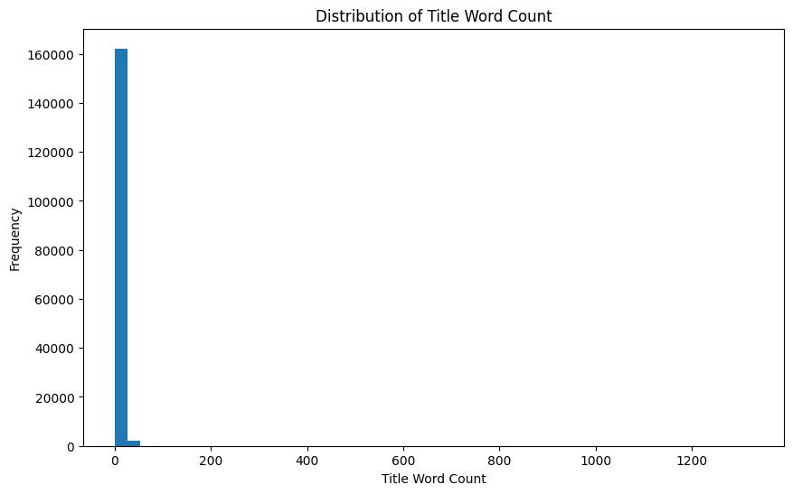
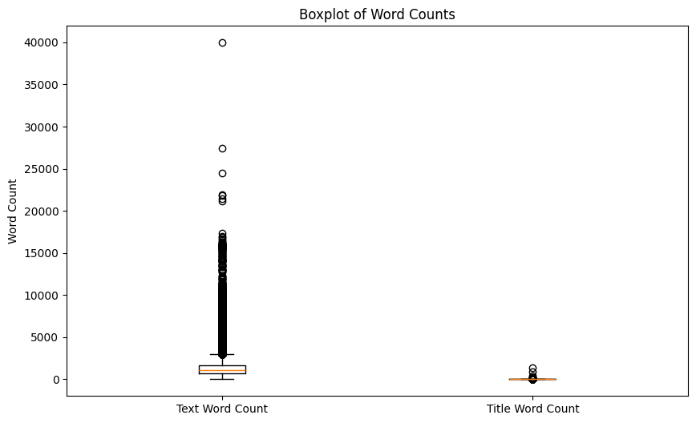
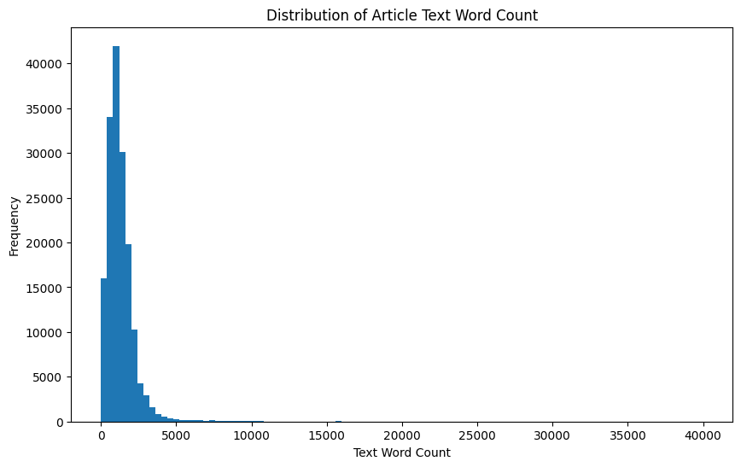
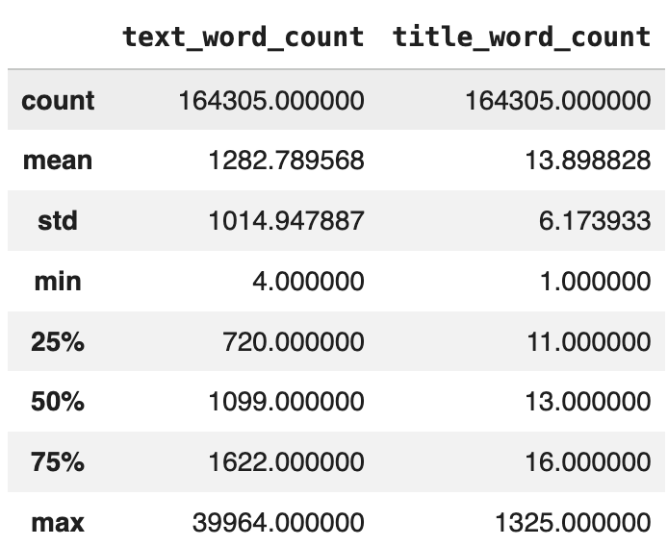
Data EDA and Preprocessing – Word Count
Used IQR method to drop 11815 article outliers
Text bounds: 0 to 2975.0
Title bounds: 3.5 to 23.5

Slide 7
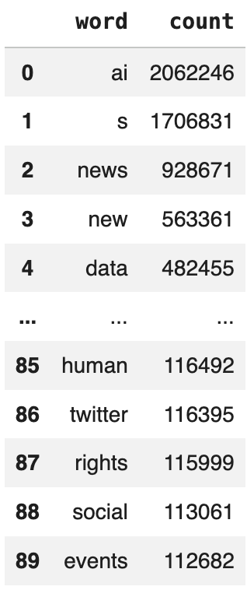
Data EDA and Preprocessing – Keep Articles with Frequent Words
Built a bag-of-words representation of the article text using CountVectorizer
Kept alphabetic terms, converted all text to lowercase, and removed English stop words
Kept only the articles containing at least one of these extremely common words (words that appear 100,000 times)
This removes articles that were likely too short, too noisy, not relevant
152,490 → 136,233 articles (dropped 16257)

Slide 8
Topic Detection

Slide 9
Topic Detection – Methodology
Tried 3 topic modeling methods on article text and titles: LDA, NMF, BERTopic
Latent Dirichlet Allocation (LDA)
Probabilistic generative model that assumes documents are mixtures of topics and topics are mixtures of words
Doesn’t capture semantic similarity (Bag-of-Words model)
Non-negative Matrix Factorization (NMF)
Matrix factorization method that decomposes a document–term matrix (TF-IDF) into smaller matrices representing topics and word weights
Deterministic and computationally efficient
Doesn’t capture semantic similarity (Bag-of-Words model)
BERTopic
Uses transformer-based embeddings to represent documents in semantic vector space
Can produce more nuanced and semantically meaningful topics by better capturing context and similarity between related phrases
Computationally expensive and stochastic
*BERTopic text was chosen as the best topic detection model since it produced the clearest and most distinct industry-based topics*

Slide 10
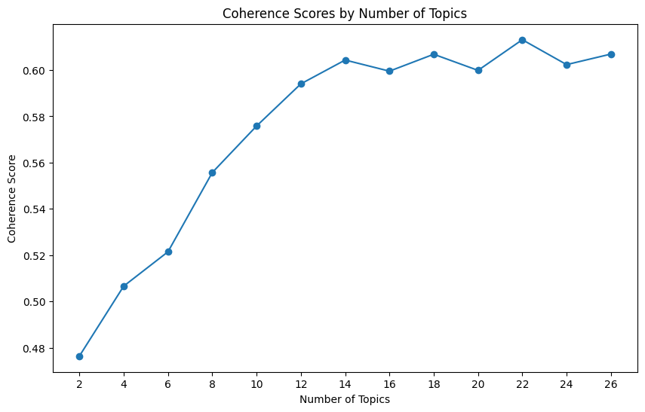
Topic Detection – LDA Text
Cleaning (based on Bag-of-Words model):
Transform to lowercase
Remove boilerplate website text, timestamps, ticker fragments, separator junk, non-letter text, and stopwords (reduces noise but may slightly limit detection of some bigrams)
Tokenized each document into a list of individual words
Trained a phrases model to detect common bigrams in the corpus
Min word count = 20 times in corpus
Phrase detection threshold = 10 (score that shows how strongly two words must be associated)
Built gensim dictionary from corpus to filter rare and overly common terms:
Remove terms that appeared in fewer than 1% of documents
Remove terms that appeared in more than 50% of documents
Converted each document into a bag-of-words representation
Trained final LDA model with 14 topics, selected based on the where coherence score starts to plateau
Refer to intertopic distance map in zip file
Topic | Industry Label
1 | Public Discussion of AI & ChatGPT
2 | AI Companies & Global Politics
3 | Enterprise AI & Cloud Solutions
4 | Local News / Media Content
5 | AI Markets, Crypto & Investment
6 | AI Tools & Generative Applications
7 | AI in Healthcare & Scientific Research
8 | Consumer Tech & AI Products
9 | Website Navigation / Social Media Content
10 | Stock Markets & Financial Trading
11 | General Industry & Product Releases
12 | India Financial & Market News
13 | Press Release Distribution Content
14 | Global Economic & Energy Markets

Slide 11
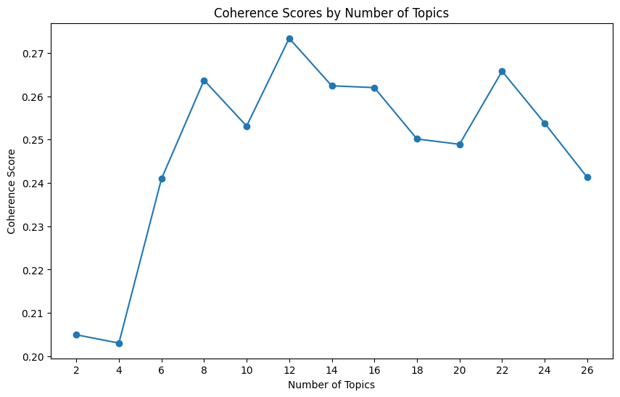
Topic Detection – LDA Title
LDA was not industry-specific enough since it relies on word co-occurrence, often grouping articles around AI/tech themes than clean industry groupings
LDA on titles performed worse than LDA on text because titles have very little context and fewer words
Applied the same cleaning and preprocessing steps used for the text version
Trained the final LDA model with 12 topics, selected based on the highest coherence score among candidate models
Refer to intertopic distance map in zip file
Topic | Industry Label
1 | General AI Market & Industry Growth
2 | AI Innovation & Technology Development
3 | Big Tech AI News
4 | Big Tech AI Products & Platforms
5 | OpenAI Leadership & Model Development
6 | Data Science & AI Infrastructure
7 | AI Chips, Stocks & Market Performance
8 | Emerging AI Technology Trends
9 | Enterprise AI & Digital Transformation
10 | Global AI Tech & Security News
11 | AI Industry Leaders & Rivalries
12 | Consumer AI Applications

Slide 12
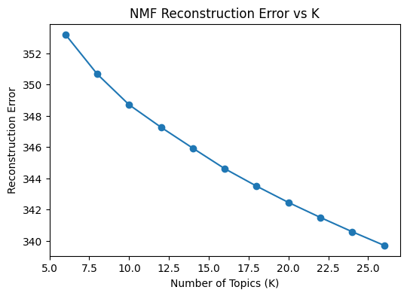
Topic Detection – NMF Text
Cleaning (based on Bag-of-Words model):
Transform to lowercase
Remove boilerplate website text, timestamps, ticker fragments, separator junk, non-letter text, and stopwords (reduces noise but may slightly limit detection of some bigrams)
Convert words into TF-IDF matrix (weights words by their frequency within a document and rarity across the corpus)
Include unigram and bigram phrases
Limit vocab to top 50000 words
Exclude words that appear in more than 60% of documents
Keep terms appearing in at least 20 documents
Selected 12 topics based on a slight elbow in the reconstruction error curve
Topic | Industry Label
0 | Enterprise Software & Digital Transformation
1 | Corporate Announcements & Press Releases
2 | Enterprise Technology & Business Solutions
3 | Financial Markets & AI Stocks
4 | Global Market News & Industry Reports
5 | Workforce & Data Science Careers
6 | Finance, Equities & Crypto Assets
7 | General News / Local News AI Coverage
8 | Local Media & News Site Boilerplate
9 | General AI Industry News
10 | Consumer Technology & Devices
11 | Date / Template Boilerplate

Slide 13
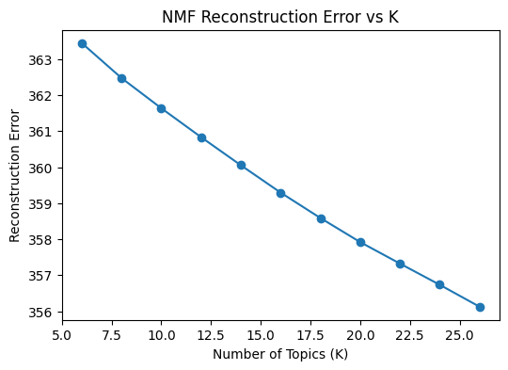
Topic Detection – NMF Title
Applied the same cleaning and preprocessing steps used for the text version
Selected 16 topics based on an extremely slight elbow in the reconstruction error curve
Topic | Industry Label
0 | General AI Industry News
1 | Workforce & Data Science Careers
2 | AI Product Launches & Applications
3 | Enterprise Generative AI
4 | Applied AI & Machine Learning
5 | OpenAI & AI Leadership News
6 | ChatGPT Consumer Use Cases
7 | General Tech News & Policy
8 | AI Stocks & Semiconductors
9 | Google AI & Cloud Platforms
10 | India & Global AI News
11 | Data Infrastructure & Enterprise AI
12 | AI Art & Visual Media
13 | AI Products, Agents & Assistants
14 | AI Crypto & Market Forecasts
15 | Elon Musk, xAI & AI Controversy
NMF was clearer than LDA, but still leaned more toward AI/tech themes than clean industry groupings since it still relies on word co-occurrence
NMF on text was broader and some topics still picked up boilerplate, where as NMF on titles was more specific, sometimes down to country or company level

Slide 14
Topic Detection – BERTopic Text
Cleaning (based on Bag-of-Words model):
Transform to lowercase
Remove boilerplate website text, timestamps, ticker fragments, separator junk, non-letter text, and stopwords (reduces noise but may slightly limit detection of some bigrams)
Generated dense document embeddings using the SentenceTransformer all-MiniLM-L6-v2 model
Applied UMAP to reduce the high-dimensional embeddings to 5 dimensions
n_neighbors=100 each document is positioned using its 100 nearest neighbors, helping preserve broader corpus structure)
min_dist=0.1 (controls how tightly points can be packed in the reduced space)
Used HDBSCAN to cluster the reduced embeddings into topics, favoring larger and more stable clusters
min_cluster_size=975 (a topic must contain at least 975 articles)
min_samples=98 (documents need a relatively dense neighborhood to be included in a stable cluster)
Convert words into TF-IDF matrix
Include unigram and bigram phrases
Limit vocab to top 30000 words
Applied a ClassTfidfTransformer so each topic could be summarized by the most distinctive terms in that cluster
Produced 18 clusters
Topic | Industry Label
-1 | Cross-Industry AI News / Outliers
0 | Enterprise Technology
1 | Consumer & Public Services
2 | Financial Services & Business
3 | Corporate AI Announcements
4 | Enterprise Software & Cybersecurity
5 | Healthcare & Life Sciences
6 | Financial Markets & Investing
7 | Media, Journalism & Public Policy
8 | Business Operations & Enterprise Automation
9 | Workforce & Compensation
10 | Cryptocurrency & Digital Assets
11 | Publishing & Intellectual Property
12 | Public AI Companies
13 | Technology Industry News
14 | Music & Entertainment
15 | African Technology Development
16 | AI Market Commentary

Slide 15
Topic Detection – BERTopic Title
BERTopic performed best producing clear topics that separate AI news by industries such as healthcare, finance, enterprise software, and consumer technology since it uses semantic embeddings that capture contextual meaning
BERTopic on titles performed worse than on text, resulting in topics that were less detailed, because titles contain less contextual information
*BERTopic text was chosen as the best topic detection model since it produced the clearest and most distinct industry-based topics*
Applied the same preprocessing, embedding model, dimensionality reduction, and TF-IDF topic representation process as the text version
Applied UMAP parameters
n_neighbors=100
min_dist=0.1
HDBSCAN parameters
min_cluster_size=500
min_samples=50
Produced 5 clusters
Topic | Industry Label
-1 | Cross-Industry AI News / Outliers
0 | Technology Industry & AI Development
1 | Workforce & Data Science Careers
2 | Global / Multilingual AI News
3 | Philanthropy & Nonprofit Sector

Slide 16
Topic Detection — BERTopic on Text Selected as Best
Topic Labels | Top Words
Cross-Industry AI News / Outliers | ai, news, new, data, share, technology, use, intelligence, video
Enterprise Technology | ai, news, new, data, technology, google, intelligence, chatgpt
Consumer & Public Services | ago, news, hours ago, hours, video, stories, said, local, file, ai
Financial Services & Business | share, ai, market, india, stock, bank, new, news, company
Corporate AI Announcements | newswires, presswire, ein presswire, ein, releases, south, new, north, distribution, ai
Enterprise Software & Cybersecurity | products, services, overview, consumer, entertain, technology, policy
Healthcare & Life Sciences | health, ai, healthcare, medical, patients, patient, news, care, cancer, research
Financial Markets & Investing | share price, price, nasdaq, share, symbols, markets, market, stocks, add, stock
Media, Journalism & Public Policy | npr, radio, public, news, schedule, donate, music, programs, community, arts
Business Operations & Enterprise Automation | gray, ai, gray media, prnewswire, media group, group, media, press release, data, release
Workforce & Compensation | salary, compensation, data scientist, scientist, data, total, salaries, pay
Cryptocurrency & Digital Assets | price, ai, mexc, market, prediction, trading, price prediction, traded, usd, btc
Publishing & Intellectual Property | new window, window, opens new, opens, new, whio, said, cox, ai, feed opens
Public AI Companies | shares, stock, nyse, nasdaq, llc, etf, price, company, soundhound, ai
Technology Industry News | webpronews, ai, advertise, like, ientry, request, advertising, tech, marketing, cmspro
Music & Entertainment | music, ai, song, spotify, voice, new, news, artists, ai music, songs
African Technology Development | africa, ai, nigeria, ago, news, african, ghana, premium, ago
AI Market Commentary | nasdaq, add, symbols, quotes, market, available, markets, currently, data, edit
BERTopic on text performed best because it incorporates semantic embeddings, producing clearer topics that are better separated by industry
Some BERTopic clusters were still either too specific or too broad, which led to overlap between topics or clusters that were not very useful for clear industry separation
Cross-Industry AI News / Outliers, Enterprise Technology, and Corporate AI Announcements were very similar, while AI Market Commentary and Financial Markets & Investing were also closely related and could potentially even overlap with Financial Services & Business
These topics shared very similar top words and similar content articles
Healthcare & Life Sciences, Music & Entertainment, Cryptocurrency & Digital Assets, Media, Journalism & Public Policy were the strongest examples of clear industry-specific topics, with distinct topic words that aligned well with their representative articles
The African Technology Development topic was coherent but was more region-specific than industry-specific, focusing on geographic context rather than a particular sector
Comment on topics and validityu and maybe put some down

Slide 17
Named Entity Recognition (NER)

Slide 18
NER – Process
Cleaned text
Removed boilerplate website text, timestamps, ticker fragments, separator junk
Did not remove stopwords, apostrophes, or lowercase the main article text, since company NER works better with the original context and capitalization
Created lowercase text version for faster technology matching and extraction
Technology extraction
Used a spaCy PhraseMatcher to detect exact technology phrases from a predefined list of AI- and technology-related terms (Generative AI assisted in creating this list)
Added regex-based aliases to capture abbreviations and variants such as LLM, RAG, and GenAI
Company extraction
Used thel en_core_web_lg spaCy model to extract organization (ORG) entities
Excluded known publisher names such as Reuters, Bloomberg, Yahoo Finance, and Associated Press
Kept strong company candidates based on formatting, capitalization, legal suffixes, and known company names
Scored extracted companies using mention count, company name quality, and known firm lists, then selected the top 3 company mentions per article (identify relevant companies and reduce noise)

Slide 19
NER – Analysis
Rank | Company | Mentions
1 | Google | 21,352
2 | Microsoft | 15,467
3 | Amazon | 10,361
4 | Apple | 8,024
5 | Instagram | 6,570
6 | Meta | 6,280
7 | Nvidia | 5,139
8 | Facebook | 4,954
9 | Nexstar Media Inc | 2,760
10 | Tesla | 2,530
Total unique companies: 71885
Total company mentions: 357926
Total unique technologies: 25
Total technology mentions: 243387
Some extracted entities in the company list are not actual companies, reflecting limitations of automated NER
ex: “Generative AI” (concept), “Research” (concept), “New Mexico” (location), “PR Newswire” (publisher)
Technology terms come from a predefined list of AI-related concepts, so the number of possible technologies detected is limited to that set
Future NER modifications
Technology extraction could be expanded using semantic similarity to find words related to the existing technology terms
Company extraction could be improved by using a stronger NER model like en_core_web_trf
Rank | Technology | Mentions
1 | Artificial Intelligence | 84,072
2 | Generative AI | 33,503
3 | Chatbot | 27,612
4 | AI Model | 24,618
5 | Large Language Model | 20,954
6 | Machine Learning | 19,631
7 | Robotics | 6,864
8 | Deep Learning | 4,369
9 | Natural Language Processing | 4,268
10 | Computer Vision | 3,314

Slide 20
Sentiment Analysis

Slide 21
Sentiment Analysis – Model Training
Model: DistilRoBERTa
Best performing transformer model for text classification
Smaller and faster (less storage, limited GPU necessary)
Dataset: ML News Sentiment Dataset (Hugging Face – sara-nabhani)
General dataset for training sentiment model (could in future find dataset aligning more with AI news)
Clean structure
Negative = 0, Neutral = 1, Positive = 2
Columns: text, label, label_name
4551 training articles, 506 test articles
Strong and balanced performance across classes despite class imbalance
Class | Precision | Recall | F1 Score | Support
Negative | 0.87 | 0.92 | 0.89 | 87
Neutral | 0.90 | 0.86 | 0.88 | 268
Positive | 0.82 | 0.85 | 0.84 | 151
Overall | — | — | — | —
Macro Avg | 0.86 | 0.88 | 0.87 | 506
Weighted Avg | 0.87 | 0.87 | 0.87 | 506

Slide 22
Sentiment Analysis – Aspect Based Sentiment Analysis (ABSA)
Built one row per aspect mention, where each aspect was either a company or a technology based on previous NER
Pulled a local text snippet (“context”) around each aspect mention
If the aspect was not found, used the first part of the article
Ran ABSA by feeding the context as the main text and the aspect as the paired text into the trained sentiment model
Predicted sentiment for each aspect mention as negative, neutral, or positive, along with class probabilities
Aggregations
By aspect: to measure how each company or technology was discussed across articles
By article: to summarize the overall sentiment of company/technology mentions within each article
By topic (NMF): to compare sentiment patterns across topic groups

Slide 23
Results and Future Considerations

Slide 24
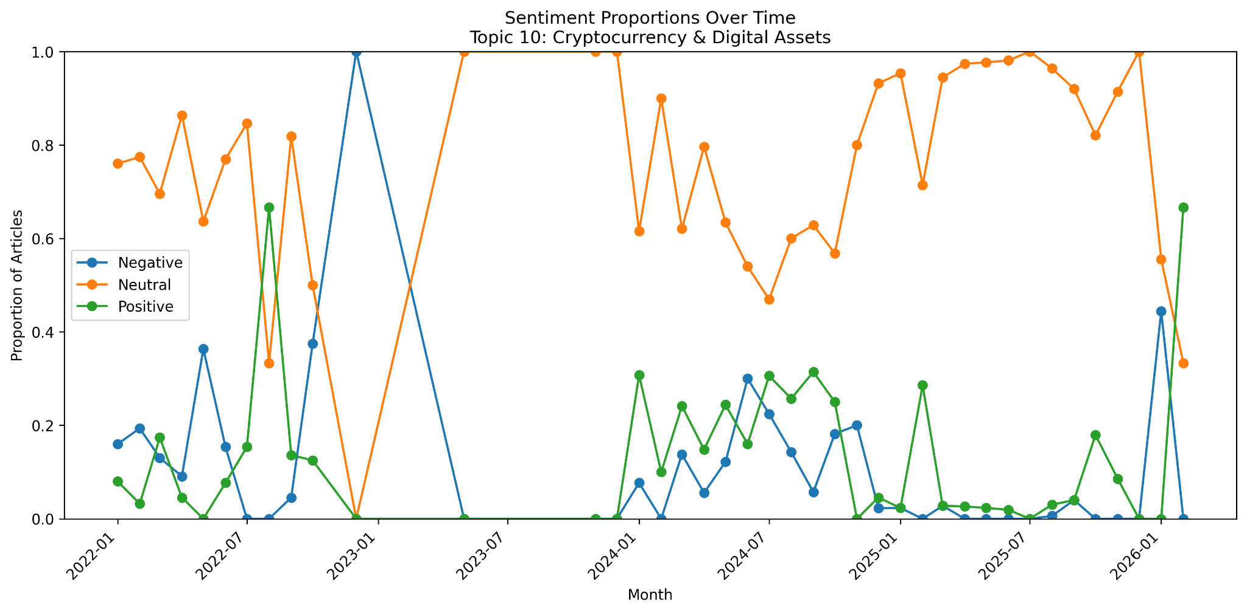
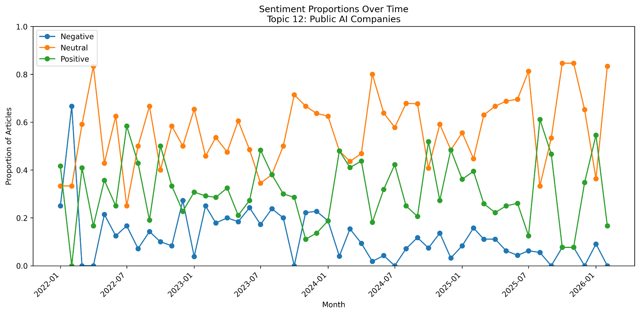
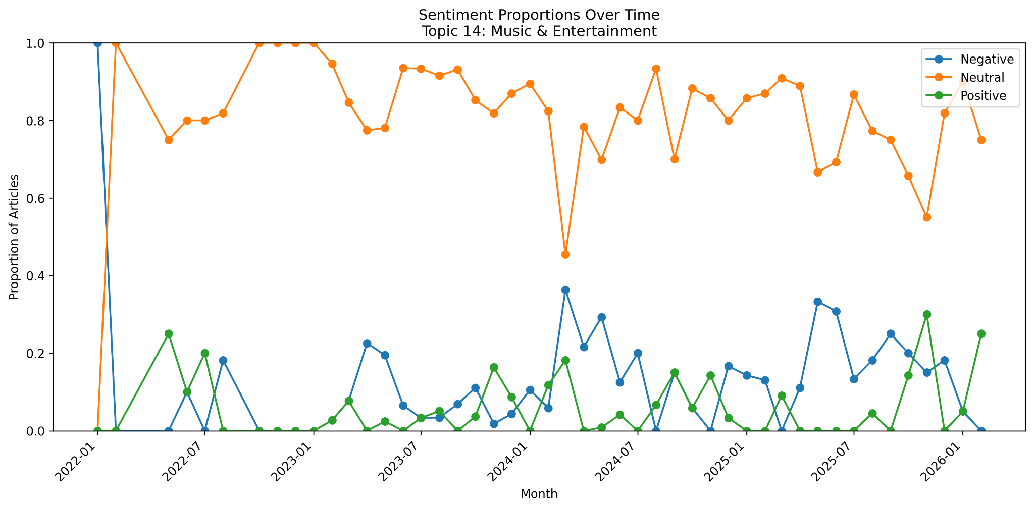
Results — Time Series
Publication dates were aggregated to the monthly level, and sentiment counts were converted into proportions
Neutral sentiment dominates across all industry topics over time, indicating that most coverage is descriptive rather than strongly opinionated
Interesting industry patterns over time:
Cryptocurrency & Digital Assets shows the greatest volatility, suggesting it is the most sentiment-sensitive topic and reacts strongly to market shocks, regulation, and technological developments
Public AI Companies shows a relatively strong positive sentiment share and a decline in negative sentiment over time, which is consistent with the broader AI boom
Music & Entertainment shows a rise in negative sentiment around 2024, likely reflecting growing concern about AI replacing creative work or threatening artists’ jobs
Financial Markets & Investing shows a higher share of negative sentiment around mid-2022, which may reflect broader market weakness during that period
Healthcare & Life Sciences shows a noticeable positive sentiment increase around November 2023, which is somewhat surprising given concerns such as healthcare-related breaches and risks at this time

Slide 25
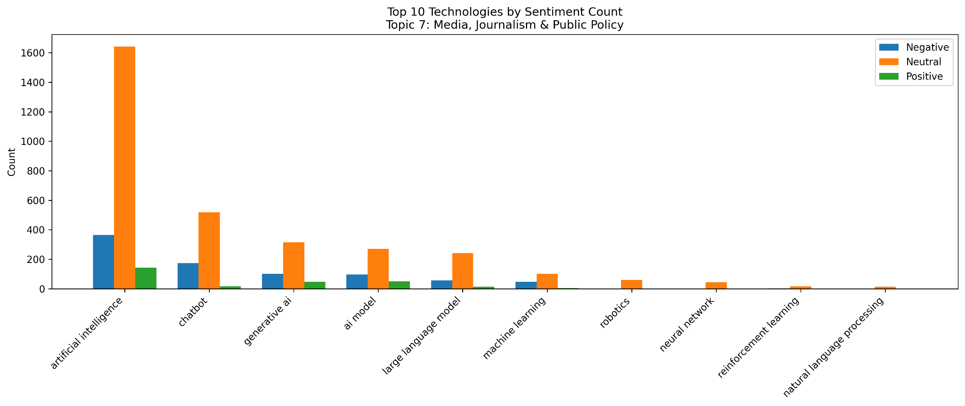
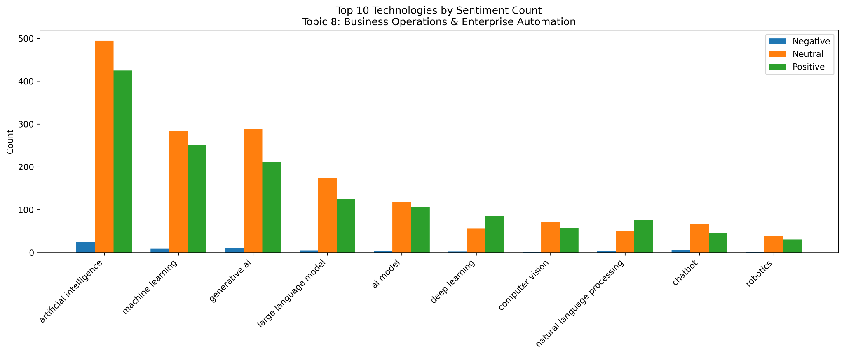
Results — Technology
Artificial Intelligence, Generative AI, Machine Learning, and Chatbots dominate across nearly every topic, indicating that these technologies are the core themes of AI-related news across industries
Neutral sentiment is consistently the largest category across technologies, reflecting the informational and reporting style typical of news articles rather than opinionated commentary
Negative sentiment is more noticeable in Media, Journalism & Public Policy, Publishing & Intellectual Property, and Music & Entertainment, likely because these topics are more closely tied to regulation, copyright, originality, and concerns about creative displacement
Positive sentiment is stronger in Business Operations & Enterprise Automation, as well as in some broader commentary and outlier groups, because these topics are more often framed around automation, product launches, innovation, growth, and new opportunities rather than criticism

Slide 26
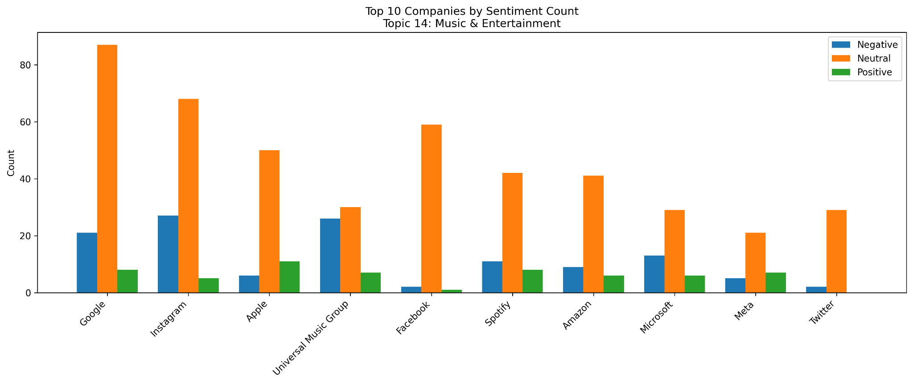
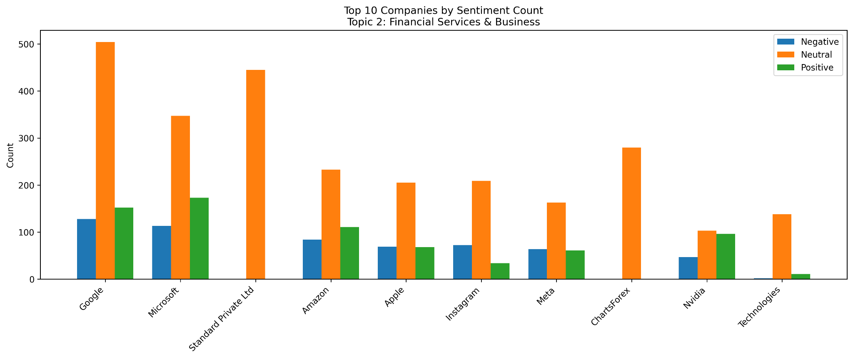
Results — Company
Neutral sentiment dominates across nearly all industries, indicating that most AI news coverage is informational rather than strongly opinionated
Large technology companies such as Google, Microsoft, Amazon, Apple, and Meta consistently appear among the most frequently mentioned entities across multiple topics, alongside industry-specific companies relevant to each topic
Consistent with the technology-level results, negative sentiment is more noticeable in Media, Journalism & Public Policy, Publishing & Intellectual Property, and Music & Entertainment, likely because these topics are more closely tied to regulation, copyright, originality, and concerns about creative displacement
Consistent with the technology-level results, positive sentiment is stronger in Business Operations & Enterprise Automation, as well as in some broader commentary and outlier groups, because these topics are more often framed around automation, product launches, innovation, growth, and new opportunities rather than criticism

Slide 27
Results – Key Takeaways
Enterprise technology, cybersecurity, and business operations are among the industries most likely to be impacted by AI over the next several years
These sectors support large enterprises, so AI adoption in these areas can have a wide ripple effect across many other industries
A small group of large technology firms dominates the AI ecosystem, with companies like Google, Microsoft, Amazon, Apple, Meta, and Nvidia appearing repeatedly across articles in different industries
These companies are leading the development, deployment, and infrastructure of AI technologies, which allows them to influence how AI is adopted across many sectors
AI adoption appears most successful when it is used to support or enhance existing work, while adoption is more difficult when it creates regulatory, ethical, or workforce disruption
Media, publishing, and entertainment show more negative or mixed effects because AI raises concerns about copyright, originality, regulation, and creative job displacement
Enterprise software, financial services, and business operations show the clearest positive impact, as AI is often framed around efficiency, innovation, and productivity gains
The main technologies driving these changes are Artificial Intelligence, Generative AI, Machine Learning, Chatbots, and Large Language Models as AI adoption is currently centered on software, data, and information systems rather than robotics or other physical automation technologies

Slide 28
Future Considerations
Topic detection improvements
BERTopic worked well because it captures semantic meaning, but results could be improved by tuning parameters (which I did do) even more or exploring additional methods to produce cleaner industry-aligned clusters
NER improvements
Organization extraction could be improved by using a stronger NER model such as en_core_web_trf instead of en_core_web_lg, which would better identify true organizations rather than concepts, people, or countries
Technology detection could be expanded using cosine similarity with embeddings, allowing related technologies to be discovered automatically instead of relying only on a predefined AI-assisted generated list
Sentiment model improvements
Sentiment analysis could benefit from training on a dataset more focused on AI or technology news, rather than general news articles
The dataset also had a large neutral class, which may have affected training, although the model still showed strong and relatively balanced performance across sentiment classes despite the imbalance → find a more balanced dataset

Slide 29
Thank You

